Slide 1
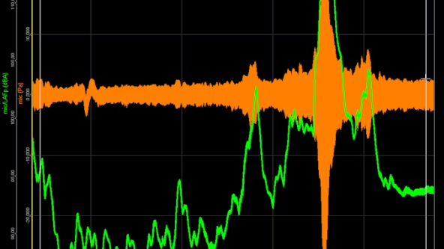
EG431D Data Acquisition
Introduction to MCU and Arduino Development Platform

Slide 2
Objectives
Describe the embedded system development process with MCUs.
Explain Arduino’s significance in IoT and prototyping.
Understand Arduino IDE’s cross-compatibility and application scalability.
Learn to install libraries for Arduino projects.
Compile, upload, and execute a sketch on an Arduino Board.

Slide 3
What is an MCU?
Compact data processing system with CPU, memory, and I/O peripherals.
Handles real-time data processing.
Key roles in sensor-based applications, motor controls, and signal analysis.
Supports communication protocols like UART, SPI, and I2C.

Slide 4
Introduction to Arduino IDE
Open-source, user-friendly platform.
Simplifies MCU programming with C.
Key components: text editor, compiler, serial terminal, and application loader.
Facilitates rapid prototyping.

Slide 5
Setting Up Your Workspace
Create a folder named “EG431D” on your desktop.
Inside, create a sub-folder named “libraries” for custom libraries.
Backup your directory at the end of each session.

Slide 6
Exploring the Arduino IDE
Open the Arduino IDE from the desktop icon.
Set preferences to link to your EG431D folder.
Key tools: text editor, compiler, serial terminal.

Slide 7
Installing Board Support
Open Board Manager (Tools > Board > Board Manager).
Search for “Arduino SAMD Boards” and install.
Connect Arduino MKR WiFi 1010 via USB.

Slide 8
Creating and Saving a Sketch
A sketch is an Arduino program.
Create a new sketch (File > New).
Save the sketch in your EG431D directory.

Slide 9
Installing Libraries
Open Library Manager (Sketch > Include Library > Manage Libraries).
Search for “blink” to find a StatusLED library.
Install the library and verify installation.

Slide 10
Compiling and Uploading a Sketch
Open an example sketch (File > Examples > Blink).
Save, compile, and upload to the Arduino board.
Verify functionality by observing the blinking LED.

Slide 11
Review Questions
What is the time for one complete LED blink?
How is the blink time set in the code?
How would you modify the code for a 1-second blink cycle?

